Slide 1
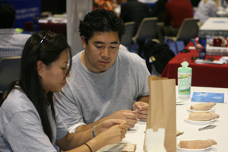
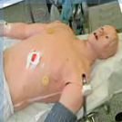
From Pigs Feet to Robots
Aligning Information Technology with the New Curriculum
presented by
Bill Eley, M.D., M.P.H. and
Chuck Elliott, M.S., M.P.A.
April 23, 2009 for the AAMC/GIR Spring Conference & Emory Site Visit

Slide 2
Desired Graduates
Physicians Passionate about Medicine and Making a Difference
Foundation of Superb Clinicians
Curious and Creative Thinkers
Lifelong Learners
Physicians Committed to Understanding the Sociological, Psychological, and Economic issues of the patient, family and community
Future Leaders
Notes:
Our first goal was to imbue in our students passion about their role as agents of change (in the lives of their individual patients and their communities).

Slide 3
Desired Curriculum
Competency Based
Increase exposure to Faculty
Integrated Basic and Clinical Science
Early Introduction to Clinical Medicine
Increase education in the Ambulatory Setting
Provide Flexibility
Include Discovery
Reduce lecture time and decrease reliance on rote memorization
Include Better methods of Assessment
Notes:
We wanted to explicitly state what competencies our students would achieve. We think the key to achieving most, if not all, of the characteristics of our desired graduates is for the students to model the behaviors of our best faculty.

Slide 4
Overview of New Curriculum
Year 1
Foundations of Medicine
Year 2
Foundations of Medicine
NBME Part I
Application of Medical
Sciences
Year 3
Application of Medical Sciences
Discovery Phase
Year 4
Translation of Medical Sciences
Notes:
We were able to agree on the basic tenets of our curriculum in time to consider what that curriculum would look like and furthermore were able to name the four phases of the new curriculum. We shortened the first two years of medical school by reducing some content, specifically reducing unneeded repetition, and combining the teaching of the normal and the abnormal. Furthermore, we moved the research experience later in the curriculum. Throughout this new curriculum we are avoiding making distinctions between basic and clinical sciences, and instead are striving to integrate the two throughout each and every phase.

Slide 5
Desired IT
Appropriate use of technology
  Right tool for the right job
Paperless
  Class notes in electronic form only
  Class content posted to Blackboard
Cost effective, scalable, and supportable
Appropriate organizational structure
  Educational Technology Managers
Notes:
The work began before the building design was completed – growth in class size, new curriculum

Slide 6
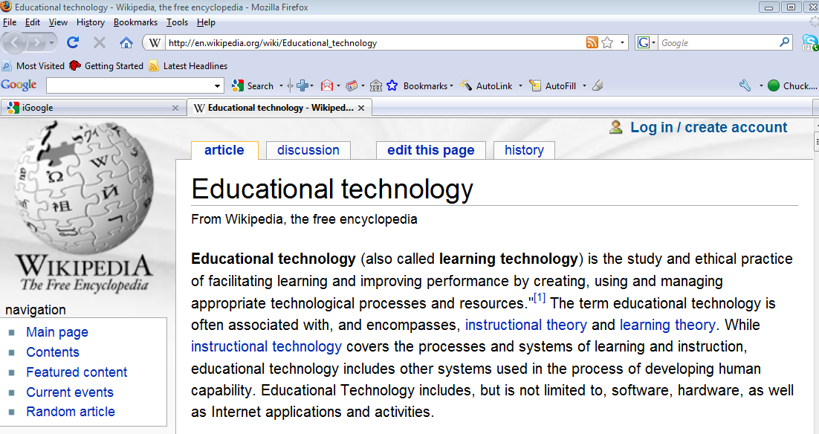
What is Educational Technology?

Slide 7
Educational Technology Managers
A/V and Multimedia Support
  Auditoria, classrooms, conference rooms, special events
Student Support
  Computer labs, classrooms, software images, Personal computing (PC and Mac), Printing and Kiosk stations, NBME online testing
Simulation Support
  OSCE, ExCEL, special equipment

Slide 8
Where the technology fits
Prior to class beginning
Account creation
Communications using LearnLink (FirstClass)
Student Portal
Student Orientation
Student Support
  provided with 512MB of Personal Network Storage
  2TB of Group Collaborative Storage Space
  basic support for the personally owned computer / laptops
    OS (Windows and Mac); Microsoft Office
    Wireless; Drivers
    LearnLink; connecting to IT infrastructure…

Slide 9
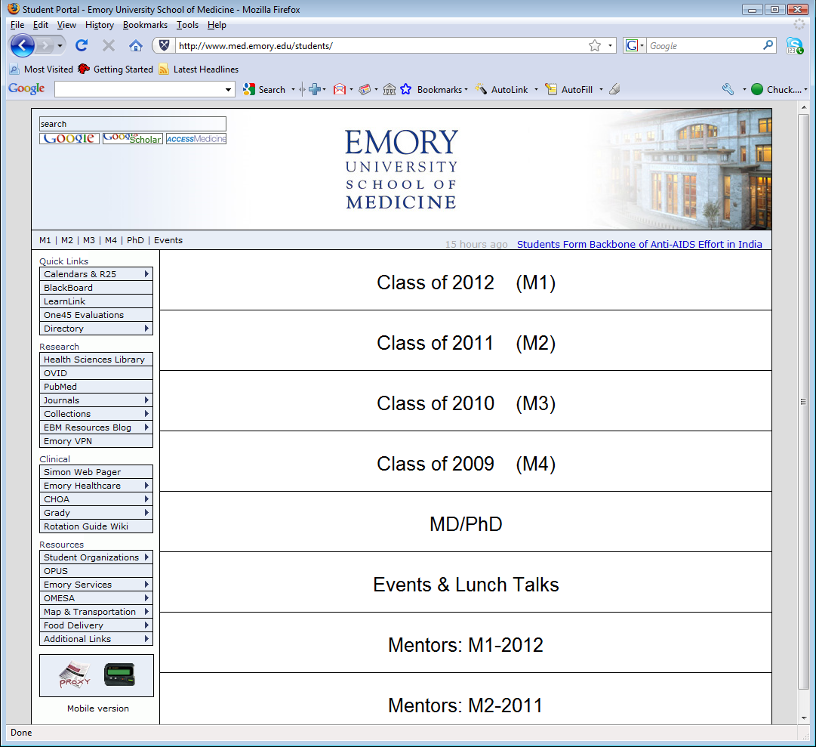
http://www.med.emory.edu/students/

Slide 10
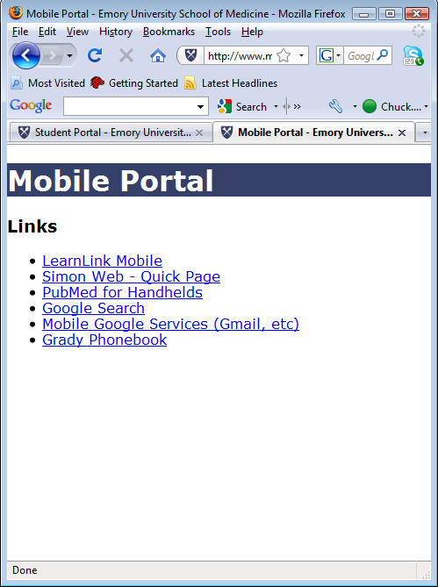
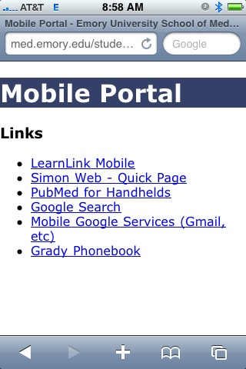
http://www.med.emory.edu/students/m/
screenshot from iPhone

Slide 11
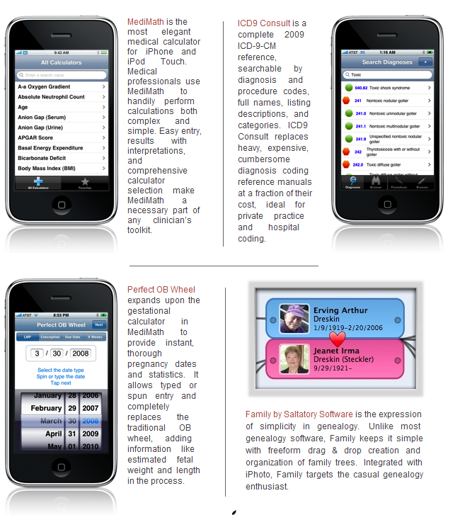

Slide 12
Integrating Students with IT
Technology Reps elected by student body
  Fill the gaps when faculty aren’t familiar
  Paid an honorarium
Monthly meetings with IT staff
Open communications
Student Orientation

Slide 13
Where the technology fits (2)
Foundations of Medicine
Auditorium presentations
  High definition, multi-source projection
  Screen large enough for detail-level viewing
  Wireless throughout education building
Small Group presentations
  20 notebook computers, pre-loaded case files
  Student breakout sessions are given expedited support due to the time constraints
Blackboard LMS
NBME Online Exams
Human Anatomy Lab (not available on today’s tour, next 5 slides)

Slide 15
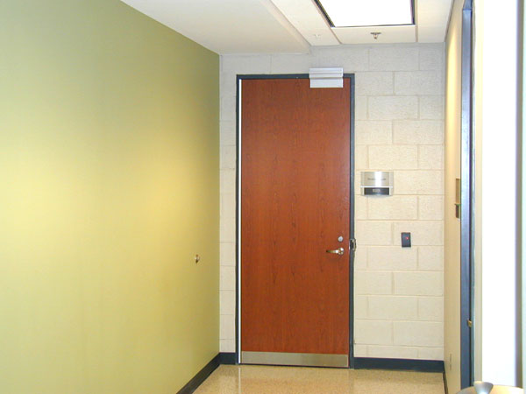
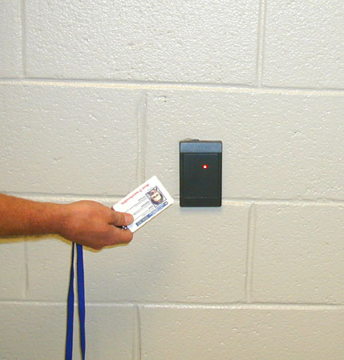
door to the dissection laboratory B37a
entry to the dissection laboratory B37a is with a card

Slide 16
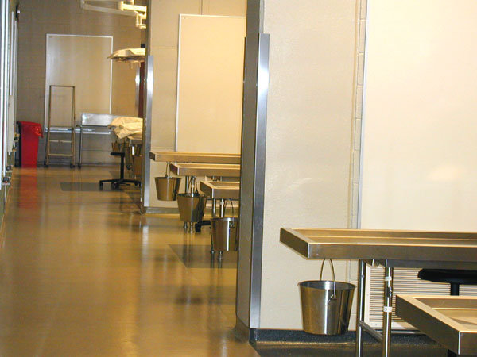
dissection laboratory
bay #c – has 10 tables (17-26)
bay #b – has 8 tables (9-16)
bay #a– has 8 tables (1-8)
floor light – for each table

Slide 17
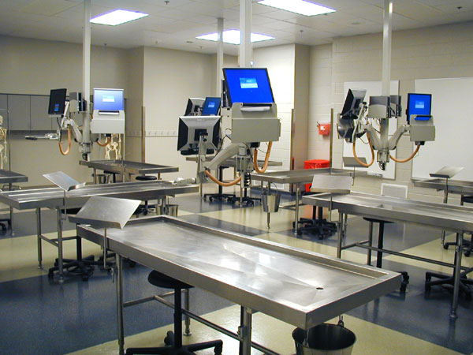
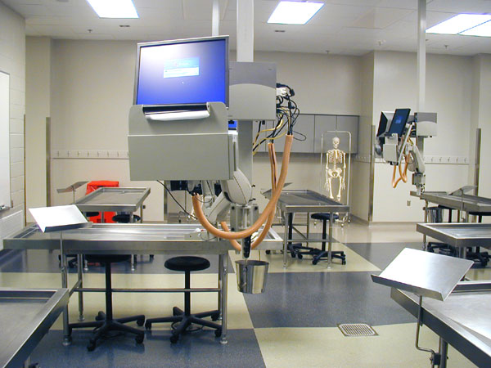
computer for each table
white board for each table
book holders for each table
2 skeletons for each bay
2 stools for each table
liquid waste bucket for each table

Slide 18
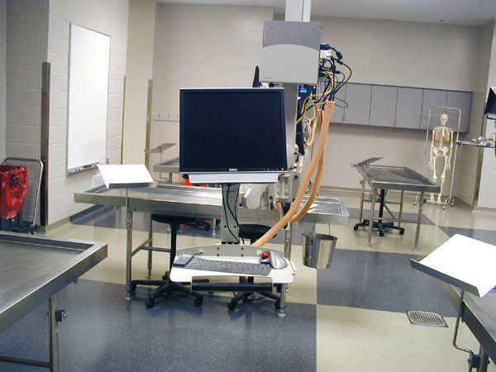
white board for each table
2 skeletons for each bay
common laboratory
container for human tissue
computer for each table
book holders for each table
2 stools for each table
liquid waste bucket for each table

Slide 19
Where the technology fits (3)
Foundations (continued)
Student Computing Labs
  Human Anatomy Lab – 22 computers
  Rooms 312/313 – 46 computers
  Laptop cart – 20 computers
Software
  UMedic – Cardiovascular Module
  Audacity- Small Group Session
  Language software; RosettaStone, Virtual Communications
  NBME – Secure Browser Plug-in
Print stations (Pharos)
  Two release stations serve 4 printers
  Black & white only, 6 cents per page, 9 cents duplex
  On track to collect $6K, recovers costs
  When Pharos is down?

Slide 20
Where the technology fits (4)
Foundations (continued)
Kiosk machines
  2 iMacs
Streaming and simulcasting
Class capture
  Accordent, purchased 7 stations
Emory Center for Experiential Learning (ExCEL)

Slide 21
Emory Center for Experiential Learning (ExCEL)
5 Gaumard simulators
  2 adult males, 1 newborn, 1 pediatric
  Noelle birthing simulator, currently housed at Midtown Hospital
  All controlled by (Motion Computing) tablets
2 METI Emergency Care Simulators (ECS)
  Controlled by Mac laptops
  METIVision version 14
  Medical Education Technology, Inc. (METI)
4 Simulation rooms, 3 cameras and 2 mics each
Using WebSP for integration

Slide 22
Where the technology fits (5)
Foundations (continued)
Specialized Software
  Neuroscience
    Neurologic Findings - used in SOM computer labs
    BrainStorm - used in Human Anatomy Lab
Objective structured clinical examination (OSCE)

Slide 23
Clinical Skills (OSCE) Center
Objective structured clinical examination (OSCE)
16 exam rooms - 4 suites, 4 exam rooms in each
  Desktop in room for (standardized patient) data entry
  Laptop outside room for (student) data entry
  2 wall-mounted cameras and ceiling mic in each
Control room
  2 desktops for event control, two 24” monitors
  LIONIS WebSP - web based, case, event, schedule, reporting

Slide 24
Overview of New Curriculum
Year 1
Foundations of Medicine
Year 2
Foundations of Medicine
NBME Part I
Application of Medical
Sciences
Year 3
Application of Medical Sciences
Discovery Phase
Year 4
Translation of Medical Sciences
Notes:
We were able to agree on the basic tenets of our curriculum in time to consider what that curriculum would look like and furthermore were able to name the four phases of the new curriculum. We shortened the first two years of medical school by reducing some content, specifically reducing unneeded repetition, and combining the teaching of the normal and the abnormal. Furthermore, we moved the research experience later in the curriculum. Throughout this new curriculum we are avoiding making distinctions between basic and clinical sciences, and instead are striving to integrate the two throughout each and every phase.

Slide 25
Where the technology fits (6)
Applications and Translation
New curriculum is in the Applications Phase (Year 1.6-2.6)
Web Page (and PDA enabled page)
  Paging system
  Student/faculty directory
  Library access, etc.
  Investigating other mobile devices
Simulation:
  Team training with Medical and School of Nursing Students together
  Procedures specific to clerkships
Extensive use of OSCE suite by clerkships
End of Applications OSCE
Emergency Medicine OSCE during Translation Phase
Senior Surgery Course in the Anatomy Lab

Slide 26
Where are we going?
Improved Curriculum Management
  Anywhere, anytime for students, faculty, alumni
Improved Student Evaluation
  Multiple Sources: Faculty, nurses, patients
  Student Dossier
Improved Integration
  Admissions→ Student Records → University Records → Alumni Records

Slide 27
What would we do differently?
Comprehensive planning for class sizes for all programs, especially non-M.D.
Technology
  Acquisitions
  A/V design
Organizational structure
Policy development

Slide 28
Thank You !
?

Slide 29
Tour of building
May leave personal belongings in room
Silence where teaching and/or learning is in progress
  auditoria, OSCE, and computer labs
Bus is leaving approximately noon

