Slide 1
Current and Emerging Trends in Educational Technology
Consortium of Ophthalmic Training Programs
November 8, 2008
Chuck Elliott, M.S., M.P.A., MCP
Chuck.Elliott@emory.edu

Slide 2
e-Learning
e-Learning: medium of instruction is computer technology, often web-based
  Chief benefits
    Cost avoidance (institutions and students)
    Time shifting
Two common models of e-Learning
  Online
    no in-person interaction required
  Hybrid
    some in-person instruction and class meetings

Slide 3
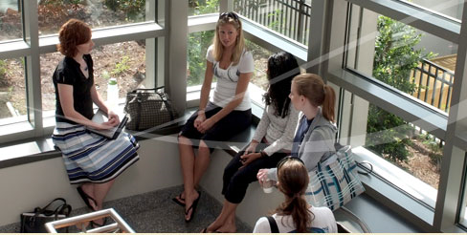
Learning Content Management Systems
Server-based systems that can provide centralized or decentralized management and role-based access to educational content
Distinguishing feature is re-use of learning objects
Commercial and Open Source products in wide use

Slide 4
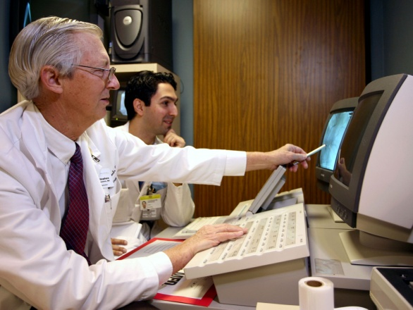
LCMS Closed (Commercial) Products
Commercial products and vendors include:
  Blackboard
  WebCT (acquired by BlackBoard in 2006)
  Desire2Learn eLearning Enterprise Suite
  ANGEL Learning Management Suite
  eCollege (hosted solution)
Notes:
Blackboard
- can be installed on servers or hosted
- in use in more than 50 countries and more than 2000 institutions
- known for litigation and filing expansive patent; inspired boycott movement
- in March, all 44 patent claims rejected by court
WebCT:
- originally dev at Univ of British Columbia and for years supported out of Vancouver
- my previous school, Marshall University, and many others are using the product
- heyday circa 2002: 80 countries, 10 million students
- many criticisms, difficult to use, Marshall experience required ample training of faculty
- will be phased out by Blackboard in 2011
Desire2Learn:
- 5 million learners worldwide
- based in Ontario
ANGEL:
- evolved from Indiana University-Purdue University Indianapolis (IUPUI)
- in use at KUMC for both basic science and nursing doctorate program;
- ANGEL ePortfolio used by students
- ANGEL Learning Isle in Second Life
eCollege
- on-demand SaaS model
- small user base in higher ed

Slide 5
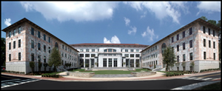
Blackboard at Emory
All faculty, students, and staff can log in
Used for teaching and learning and…
  Social networking
  Collaboration
  Administrative service (committees)

Slide 6
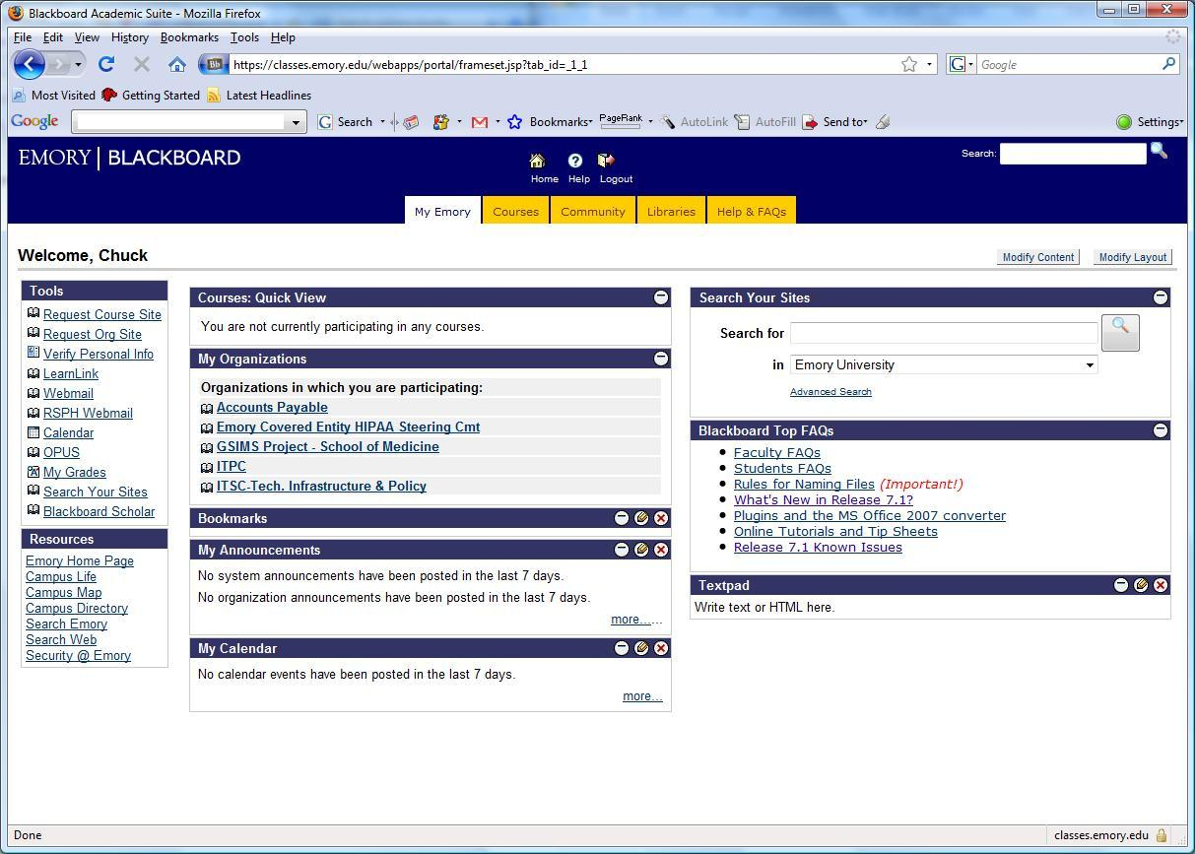
Blackboard at Emory University

Slide 7
LCMS Open (Free) Products
The Sakai Project
  Sakai CLE (Collaboration and Learning Environment)
  Project began in 2004
  Founding Institutions
    Indiana University; MIT; Stanford
    University of Michigan; Polytechnic University of Valencia
    uPortal; Open Knowledge Initiative
  Java based
  In use at more than 160 institutions worldwide
Notes:
Sakai:
- The Sakai Project began in 2004
- java based
- in use at more than 160 institutions, pilots at 100 plus
-
Moodle
- based in Perth, Australia
- a PHP based system, now supports Oracle and MS SQL db
- 50,000+ sites, 26+ million users
-

Slide 8
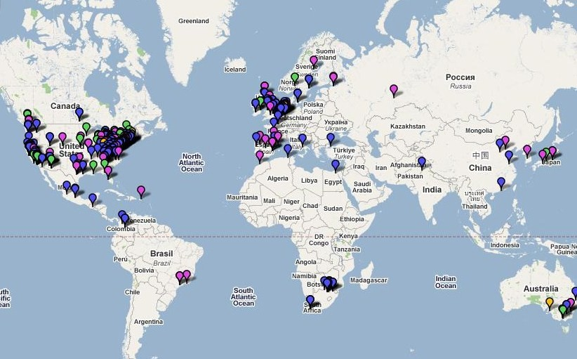
Sakai Map
October, 2008

Slide 9
LCMS Open (Free) Products
Moodle (Modular Object-Oriented Dynamic Learning Environment)
  PHP based system
    Unix, Linux, Windows, Mac OS X
  now supports Oracle and Microsoft SQL Server
  More than 50,000 sites
  More than 26 million users
Notes:
Moodle
- based in Perth, Australia
- a PHP based system, now supports Oracle and MS SQL db
- 50,000+ sites, 26+ million users
-

Slide 10
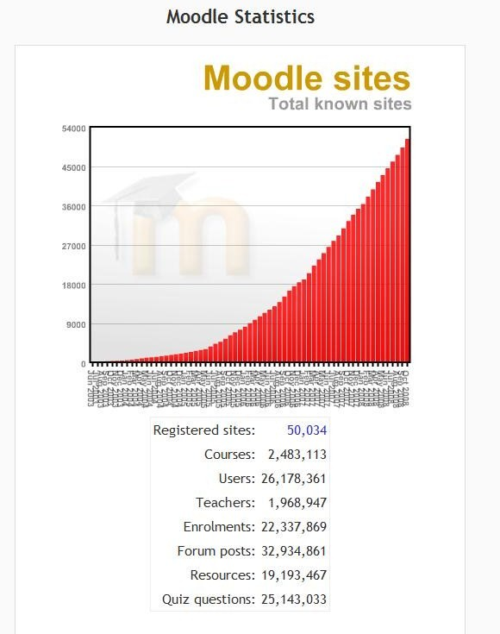
Moodle Stats http://moodle.org/sites/
Notes:
June 2003 through October 2008

Slide 11
Gartner Research findings
57% of institutions have two or more e-learning platforms on campus; 82% have designated a single standard. The overlap is mostly attributed to tests of alternative platforms, but also to the usual "academic freedom."
There is a clear movement in the market toward more OSS e-learning platforms such as Moodle and Sakai, with 26% of platforms on campuses being OSS in 2007 and 35% projected for 2008.
Commercial e-learning platforms are still in the majority; as being the major platform for course delivery (75%) and as a designated standard (62%).

Slide 12
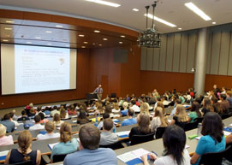
Class Capture
“Capturing” or recording audio, video, and sources of instruction
  May include post-production editing
  May be limited to a wide-angle preset camera or more professional production
  May be limited to audio only
Output files provided to students
  Via secured servers
    (including LCMS servers)
iTunes U. (130+ participating universities) or some other platform

Slide 13
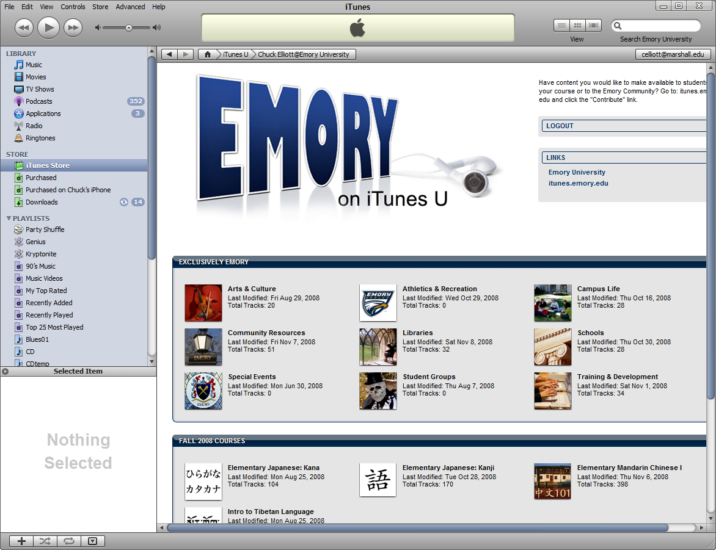
Class Capture

Slide 14
Class Capture
Technical Issues
  Quickly consumes online storage
  System interdependencies
  Automated scheduling and publishing
Costs $$$
Legal Issues
  Many faculty exercise “fair use” rights to copyrighted material
  Patient “consent” in medicine and allied health
Personal Preferences
  Faculty may not consent to being recorded

Slide 15
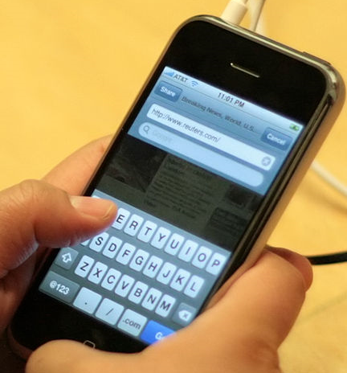
Consumer Technologies
Mobile devices
  Windows Mobile
  iPhones, iPods, iTouch
  Google Android
Improved wireless services
  3G
  Wireless N
Significantly impacting society and classrooms

Slide 16
Simulation in Medical Education
Clinical Skills Assessment
  Objective Structured Clinical Examination (OSCE)
  Combines many of the technologies discussed today
New Emory SOM Building
  Four Suites, each with four wired exam rooms
  Total sixteen exam rooms, each wired for audio and 2 articulating cameras
  Standardized patients (paid actors)
  Control room allows one or two operators to execute fine camera control

Slide 17
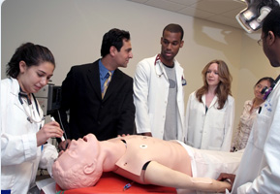
Robotics in Medical Education
ExCEL (The Emory Center for Experiential Learning)
  high-fidelity simulators allow students to acquire and hone technical skills
    basic suturing
    resuscitation
    Intubation
    placement of IVs
    delivering a baby
Emory Simulation, Training, and Robotics Center (ESTAR) http://www.surgery.emory.edu/estar/

Slide 18

Thank You !

